Slide 1
Stellar Object Detection
A project by:
Mohammed Hussain Shaikh

Slide 2
Index
Introduction
Understanding the scope of the project
1.
Data Collection
Importing the data and understanding features
2.
Exploratory Data Analysis
Deriving correlations and feature importance
3.
4.
Feature Engineering
Dividing the data into train, test sets.
Model Training
Training different models on the data
5.
6.
Model performance
Comparing and evaluating model performance
7.
Conclusion
Inferences from the project

Slide 3
Introduction
Stellar object detection is a critical area of research in astronomy and astrophysics, focusing on identifying and classifying various celestial bodies such as stars, galaxies, nebulae, and other astronomical phenomena. With the vast amount of data generated by telescopes and space observatories, automated detection and classification systems are essential for efficiently analyzing and understanding the universe.
The process involves using advanced machine learning techniques, particularly in image processing, to detect these objects within large datasets of astronomical images. Accurate detection helps astronomers study the characteristics, behavior, and evolution of celestial objects, contributing to our understanding of the cosmos. This field also aids in discovering new objects and phenomena, which could lead to significant scientific breakthroughs.
The aim of this project is to implement the knowledge acquired, to implement a machine learning model, in order to automatically detect a stellar object.

Slide 4
Goal of the project
This project aims to develop machine learning models to classify celestial objects into stars, galaxies, and quasars. This project aims to facilitate efficient automated classification, insights into distinguishing features, and optimized data processing for large-scale surveys through the predictive models, data visualizations, and a comparative analysis of various algorithms.

Slide 5
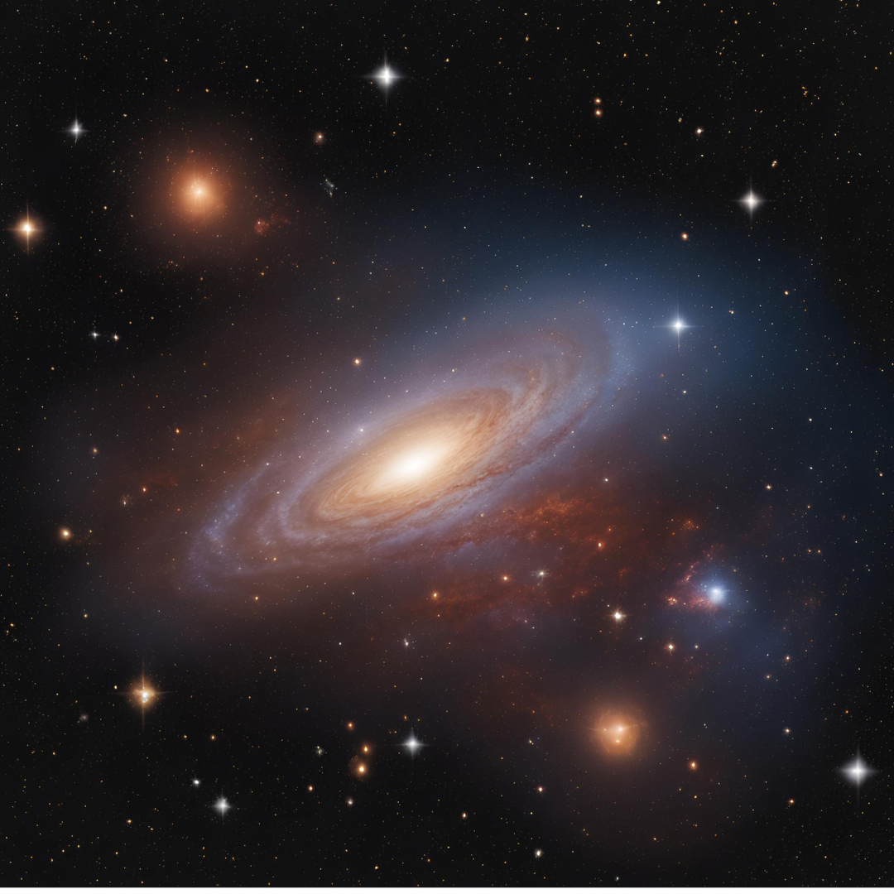
Data Collection
The data used in this project is from the Sloan Digital Sky Survey (SDSS) dataset, which is one of the most extensive and detailed astronomical datasets available, widely used in the field of astrophysics for research and analysis.
The SDSS is a multi-spectral imaging and spectroscopic redshift survey, conducted using a dedicated 2.5-meter telescope at Apache Point Observatory in New Mexico, USA.
The primary goal of the SDSS is to map the universe in three dimensions by observing the sky in five different color bands, capturing images and spectra of millions of celestial objects, including stars, galaxies, and quasars.
Image: Generated using MS designer AI

Slide 6
Understanding Features
The dataset contains the following columns.
obj_ID: Object Identifier, the unique value that identifies the object in the image catalogue used by the CAS
alpha: Right ascension (RA), denoted by alpha, is the angular distance of a celestial object measured eastward along the celestial equator from the vernal equinox.
delta: Declination (DEC), denoted by delta, is the angular distance of a celestial object north or south of the celestial equator.
u: Ultraviolet filter in the photometric system
g: Green filter in the photometric system
r: Red filter in the photometric system
i: Near Infrared filter in the photometric system
z: Infrared filter in the photometric system

Slide 7
100000
100000
run_ID: Run Number used to identify the specific scan
rereun_ID: Rerun Number to specify how the image was processed
cam_col: Camera column to identify the scanline within the run
field_ID: Field number to identify each field
spec_obj_ID: Unique ID used for optical spectroscopic objects (this means that 2 different observations with the same spec_obj_ID must share the output class)
class: object class (galaxy, star or quasar object)
redshift: redshift value based on the increase in wavelength
plate: plate ID, identifies each plate in SDSS
MJD: Modified Julian Date, used to indicate when a given piece of SDSS data was taken
fiber_ID: fiber ID that identifies the fiber that pointed the light at the focal plane in each observation
The dataset contains 100000 rows and 18 columns, which do not have null values.

Slide 8
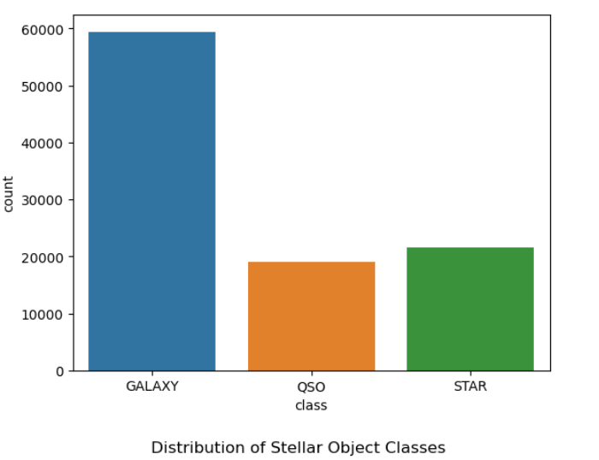
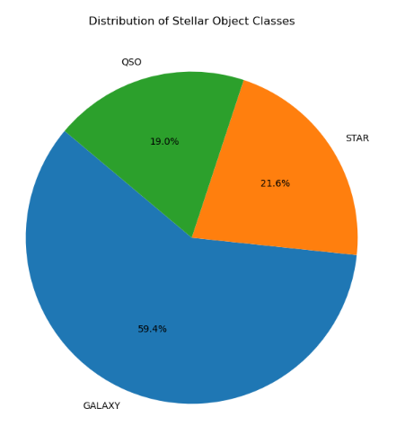
The dataset has:
59445 rows for class Galaxy
21594 rows for class Star
18961 rows for class Quasar
This makes the dataset have the following distribution.

Slide 9
The exploratory data analysis, gives an insightful overview of the dataset, helping us understand the correlations between columns and the classification.
With the use of visuals, we can easily break down the correlations between the features and the classifications.
The EDA is a fundamental step in creating efficient models for prediction.
The dataset, turned out to have no NULL values, however outliers were notices using the IQR of box plot, and were handled accordingly.
Univariate and multivariate analysis were used accordingly in order to get correlations and data distributions.
Exploratory Data Analysis

Slide 10
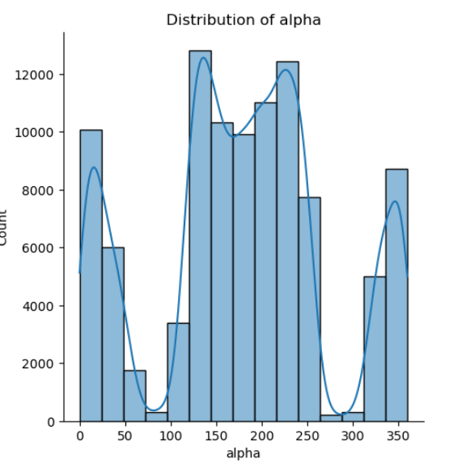
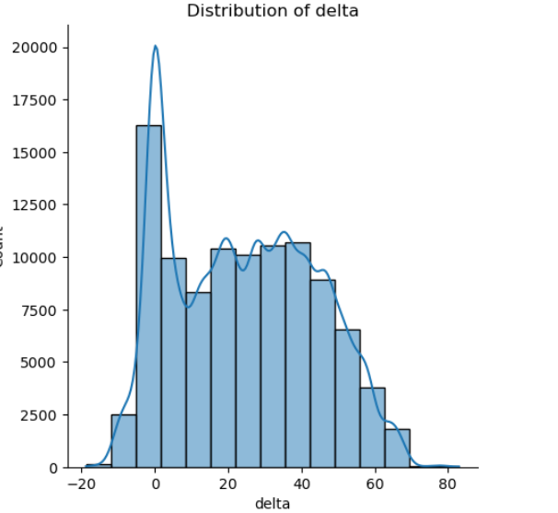
Univariate analysis
Distribution of columns.
For the alpha column:
Maximum values lie in the range of 100
to 250, whilst a significant proportion also
have a distribution on the extreme ends.
For the delta column:
For the delta column:
The data is almost uniformly distributed , with a slight peak close to the value of 0.

Slide 11
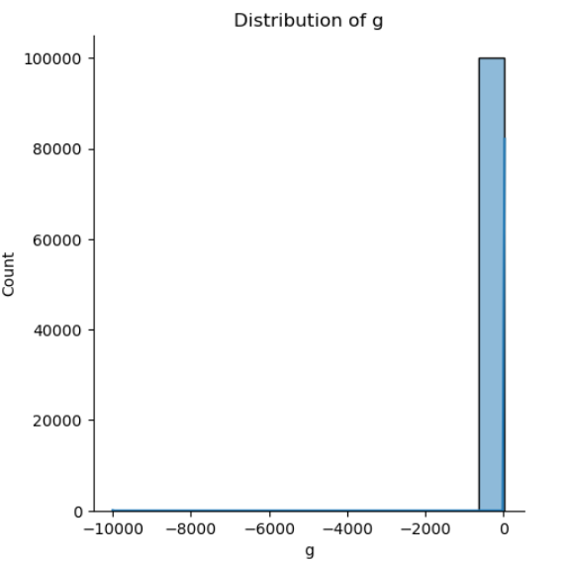
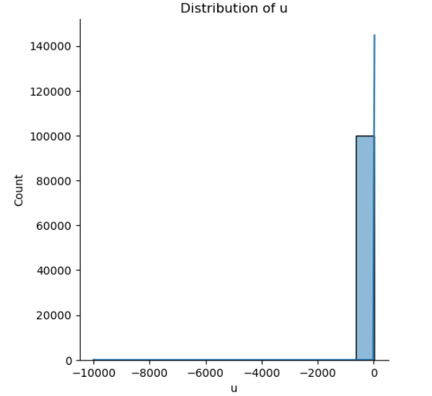
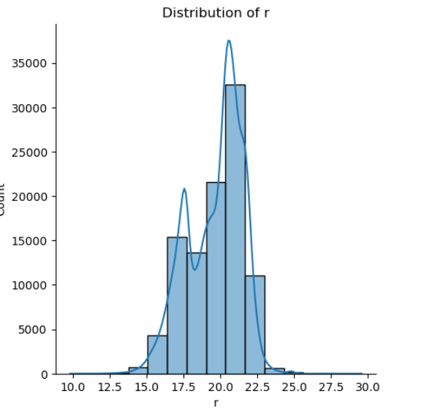
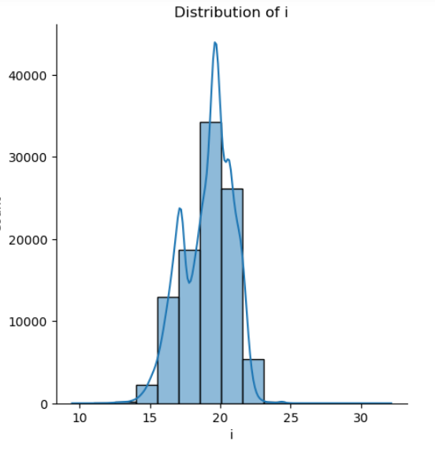
The columns u and g show no distribution, and are locally distributed within a range close to 0.
The columns r and i are somewhat normally distributed over a range of values.

Slide 12
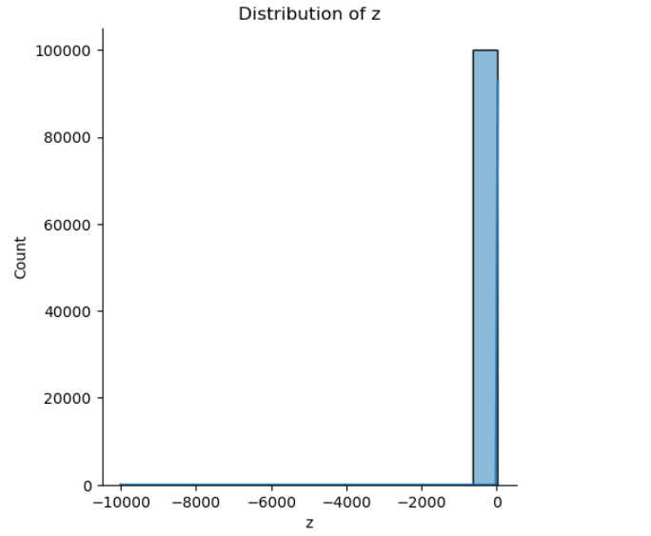
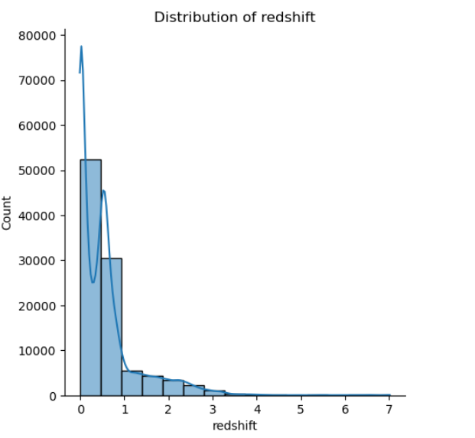
The values of z are distributed similarly to those of the columns u and g.
The redshift column is left skewed distribution, with majority values lying in the range 0 to 1.

Slide 13
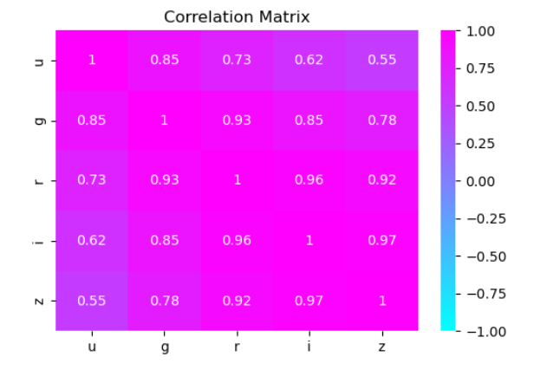
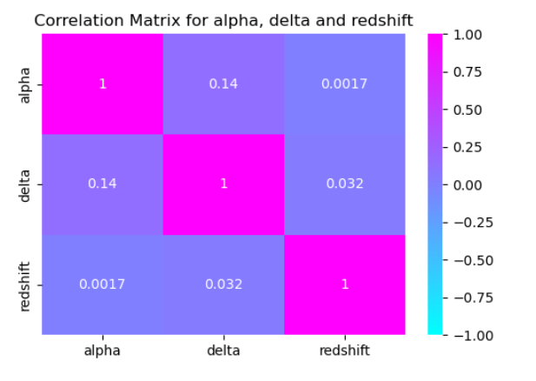
Multivariate analysis
Correlation between photometric filters, shows a positive and a very high correlation.
The correlation matrix between alpha, delta, and redshift indicates a weak correlation among these variables.

Slide 14
Feature Engineering
Preprocessing
The columns, obj_ID ,spec_obj_ID , run_ID, rerun_ID, field_ID and fiber_ID are only used for identification and serve no purpose in the classification, and so we drop these columns.
The columns u, i, g, r, z are photometric columns and have a very high correlation among themselves indicating importance.
The columns alpha, delta and redshift are spectrometric, have weak correlation, but are important in terms of classification.
The other columns, such as ‘MJD’, ‘cam_col’ and ‘plate’ give information about the lens, which was used to capture the data, removing these columns leads to poor prediction.

Slide 15
Train Test Split
Next we divide the dataset into x and y , where x includes all the columns and y includes the ‘class’, which was label encoded.
We divide the data into train and test sets where 80% data is used for training, and 20% is used for testing
We use a random state value of 42 for the split.

Slide 16
The following models were chosen for the classification.
Logistic Regression:
Logistic regression is a statistical method used for binary classification tasks. It models the relationship between a dependent binary variable and one or more independent variables by estimating probabilities using the logistic function, enabling predictions of categorical outcomes.
Model Selection
Decision Tree Classifier:
A decision tree classifier is a model that splits data into branches based on feature values, creating a tree-like structure. Each node represents a decision rule, and leaves represent outcomes, making it easy to interpret and visualize.

Slide 17
KNN ( K-Nearest Neighbors)
K-Nearest Neighbors (KNN) is a simple, non-parametric classification algorithm that assigns a class based on the majority vote of the nearest neighbors in the feature space. It's intuitive but computationally intensive, especially with large datasets.
Support Vector Machine (SVM)
Support Vector Machine (SVM) is a powerful classification algorithm that finds the optimal hyperplane to separate data into different classes. It is effective in high-dimensional spaces and works well with both linear and non-linear data using kernel functions
AdaBoost
AdaBoost, or Adaptive Boosting, is an ensemble technique that combines weak classifiers to create a strong classifier. It iteratively adjusts the weights of misclassified instances, focusing on harder-to-classify samples, thereby improving overall model accuracy.
Random Forest:
Random Forest is an ensemble learning method that builds multiple decision trees and combines their predictions. Each tree is trained on a random subset of the data and features, improving accuracy, reducing overfitting, and handling large datasets effectively.

Slide 18
Model Evaluation
Model | Precision % | Accuracy % | Recall % | F1-Score %
Logistic Regression | 95.554 | 95.565 | 95.565 | 95.524
Decision Tree | 96.548 | 96.545 | 96.545 | 96.546
K-NN | 93.269 | 93.245 | 93.245 | 93.209
SVM | 96.053 | 96.070 | 96.070 | 96.030
AdaBoost | 68.119 | 79.845 | 79.845 | 72.100
Random Forest | 97.803 | 97.815 | 97.815 | 97.801

Slide 19
Inferences
For the following dataset, the random forest classifier performs robustly with an accuracy of 97.81% and a precision of 97.80 %.
The other models also perform significantly good, and with more fine adjustments we should be able to get close to perfect scores from all.
However, the AdaBoost model performs the worst in classifying the stellar objects.

Slide 20
Conclusion
The project helped me understand and implement machine learning principles at a much higher level.
With the help of this project, I successfully implemented a machine learning model, which could automatically detect stellar objects such as galaxies, quasars and stars.
The maximum model accuracy that was achieved was 97.82 %.

Slide 21
Thank You!

